Slide 1
Regular Expression
Course Code:CSC3220
Course Title: Compiler Design
Dept. of Computer Science
Faculty of Science and Technology
Lecturer No: |  | Week No: |  | Semester:
Lecturer: | Md Masum Billah, billah.masumcu@aiub.edu

Slide 2
Lecture Outline
Definition of a Regular Expression
Rules of a Regular Expression
Examples
Exercises

Slide 3
Objectives and Outcomes
Objectives:
Understand the basic concept of Regular expression
Understand the regular expression algorithm
Outcome:
Students should be able to design the nondeterministic finite automate from regular expression.
Students should be able to know the applications of a regular expression.

Slide 4
Regular Expression
Definition: A sequence of symbols and characters expressing a string or pattern to be searched for within a longer piece of text.
Another words to say a regular expression is a method used in programming for pattern matching. Regular expressions provide a flexible and concise means to match strings of text.
The regular expressions are built recursively out of smaller regular expressions, using some rules.
Each regular expression r denotes a language L(r), which is also defined recursively from the languages denoted by r ' s subexpressions.

Slide 5
Regular Expression
The regular expressions are built recursively out of smaller regular expressions, using some rules.
Each regular expression r denotes a language L(r), which is also defined recursively from the languages denoted by r ' s subexpressions.

Slide 6
Rules of Regular Expression
Here are the rules that define the regular expressions over some alphabet £ and the languages that those expressions denote.
Basis
Induction
Precedence

Slide 7
Rules of Regular Expression
BASIS: There are two rules that form the basis:
E is a regular expression, and L(E) is {E}, that is, the language whose sole member is the empty string.
If a is a symbol in E, then a is a regular expression, and L(a) = {a}, that is, the language with one string, of length one, with a in its one position. Here italics is used for symbols, and boldface for their corresponding regular expression.

Slide 8
Rules of Regular Expression
INDUCTION: There are four parts to the induction. Suppose r and s are regular expressions denoting languages L(r) and L(s), respectively.
(r)|(s) is a regular expression denoting the language L(r) U L(s).
(r)(s) is a regular expression denoting the language L(r)L(s).
(r)* is a regular expression denoting (L(r))*.
(r) is a regular expression denoting L(r).The last rule says that we can add additional pairs of parentheses around expressions without changing the language they denote.

Slide 9
Example of a Regular expression
Let E = {a, b}.
1. The regular expression a|b denotes the language {a, b}.
2. (a|b)(a|b) denotes {aa, ab, ba, bb}, the language of all strings of length two over the alphabet E.
Another regular expression for the same language is aa|ab|ba|bb.
3. a* denotes the language consisting of all strings of zero or more a's, that is, { E, a , a a , a a a , . . . }.

Slide 10
Example of a Regular expression
Let E = {a, b}.
4. (a|b)* denotes the set of all strings consisting of zero or more instances of a or b, that is, all strings of a's and b's: {E ,a, b,aa, ab, ba, bb,aaa,...}.
Another regular expression for the same language is (a*b*)*.
a|a*b denotes the language {a, b, ab, aab, aaab,...}, that is, the string a and all strings consisting of zero or more a's and ending in b.

Slide 11
Operations of a Regular expression
Operations:
The various operations on languages are:
Union of two languages L and M is written as
L U M = {s | s is in L or s is in M}
Concatenation of two languages L and M is written as
LM = {st | s is in L and t is in M}
The Kleene Closure of a language L is written as
L* = Zero or more occurrence of language L.

Slide 12
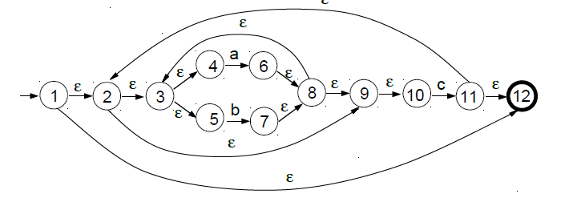
Regular Expression To NFA
Outline the NFA generated by the construction of Thompson relevant to the following regular expression:
Example: ((a | b)*c)*

Slide 13
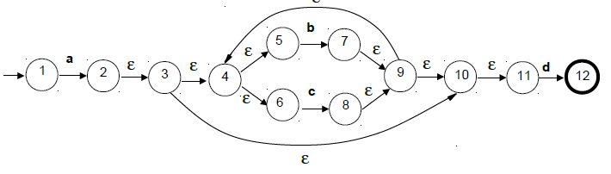
Regular Expression To NFA
By means of the construction of Thompson, outline the NFA relevant to the following regular expression:
Example: a (b | c)*d

Slide 14
Regular Expression To NFA
By means of the construction of Thompson, outline the NFA relevant to the following regular expression:
Example: a (b | c)*d
Class Exercises
(aUb)*abc
(abUbc(abUc)*)*

Slide 15
NFA to DFA Conversion (Subset Construction Method)
Course Code: CSC3220
Course Title: Compiler Design
Dept. of Computer Science
Faculty of Science and Technology
Lecturer No: | 8 | Week No: | 8 | Semester:
Lecturer: | Md Masum Billah, billah.masumcu@aiub.edu Masum-billah.net

Slide 16
Lecture Outline
NFA TO DFA (Subset Construction Method)
Subset Construction Algorithm
DFA Designing
Example
Exercise
References

Slide 17
Objective and Outcome
Objective:
To explain the subset construction algorithm/method for converting a Non deterministic machine to deterministic machine.
Provide necessary example and explanation of NFA to DFA conversion method using subset construction method.
To explain and practice Deterministic Finite Automata (DFA) Machine Design for a given Grammar.
Outcome:
After this lecture the students will be capable of demonstrating the subset construction algorithm
After this lecture the student will be able to convert an NFA to relevant DFA by following subset construction method.
After this class student will be able to design and demonstrate DFA construction from a given Grammar.

Slide 18
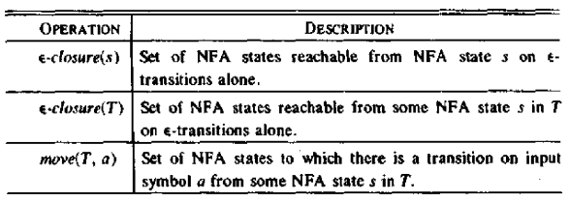
NFA to DFA Conversion
Subset Construction Algorithm
Input: An NFA N
Output: A DFA D accepting the same language
Method: Constructs a transition table Dtran for D. Each DFA state is a set of NFA states and construct Dtran so that D will simulate “in parallel” all possible moves N can make on a given input string

Slide 19
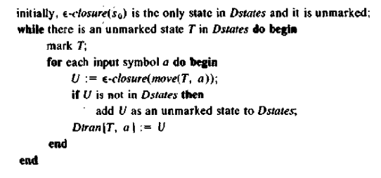
NFA to DFA Conversion
Subset Construction Algorithm

Slide 20
NFA to DFA Conversion
ε-closure and move Examples
a
1
2
ε-closure({0}) = {0,1,3,7} move({0,1,3,7},a) = {2,4,7} ε-closure({2,4,7}) = {2,4,7} move({2,4,7},a) = {7} ε-closure({7}) = {7} move({7},b) = {8} ε-closure({8}) = {8} move({8},a) = ∅
ε
start
ε
a
b
b
0
3
4
5
6
a
b
ε
7
8
Alphabet / Symbol = {a, b}

Slide 21
Subset Construction Algorithm
Subset Construction Algorithm
The subset construction algorithm converts an NFA into a DFA using:
ε-closure(s) = {s} ∪ {t ⏐ s →_{ε} … →_{ε} t} ε-closure(T) = ∪_{s∈T} ε-closure(s) move(T,a) = {t ⏐ s →_{a} t and s ∈ T}
The algorithm produces:
D_{states} is the set of states of the new DFA consisting of sets of states of the NFA
D_{tran} is the transition table of the new DFA

Slide 22
Subset Construction Algorithm
Algorithm Explained
Create the start state of the DFA by taking the ε-closure of the start state of the NFA
Perform the following for the DFA state:
Apply move to the newly-created state and the input symbol; this will return a set of states.
Apply the ε-closure to this set of states, possibly resulting in a new set.
This set of NFA states will be a single state in the DFA.
Each time we generate a new DFA state, we must apply step 2 to it. The process is complete when applying step 2 does not yield any new states.
The finish states of the DFA are those which contain any of the finish states of the NFA

Slide 23
Subset Construction Algorithm
Algorithm with while Loop
fun nfa2dfa start edges =
let val chars = nodup(sigma edges)
val s0 = eclosure edges [start]
val worklist = ref [s0]
val work = ref []
val old = ref []
val newEdges = ref []
in while (not (null (!worklist))) do
( work := hd(!worklist)
; old := (!work) :: (!old)
; worklist := tl(!worklist)
; let fun nextOn c = (Char.toString c
,eclosure edges (nodesOnFromMany (Char c) (!work) edges))
val possible = map nextOn chars
fun add ((c,[])::xs) es = add xs es
| add ((c,ss)::xs) es = add xs ((!work,c,ss)::es)
| add [] es = es
fun ok [] = false
| ok xs = not(exists (fn ys => xs=ys) (!old)) andalso
not(exists (fn ys => xs=ys) (!worklist))
val new = filter ok (map snd possible)
in worklist := new @ (!worklist);
newEdges := add possible (!newEdges)
end
);
(s0,!old,!newEdges)
end;

Slide 24
NFA to DFA Conversion
Subset Construction Method (Example-1)
NFA:
ε
a
2
3
ε
ε
ε
ε
start
a
b
b
0
1
6
7
8
9
10
ε
ε
b
4
5
ε
Regular Expression: (a | b)* abb

Slide 25
Subset Construction Method (Example-1)
ε
a
2
3
ε
ε
ε
ε
start
a
b
b
0
1
6
7
8
9
10
ε
ε
b
4
5
ε
DFA State | E-closure of | E-closure outcome states
A | E-closure ({0}) | 0,1,2,4,7
B | E-closure ({3,8}) | 1,2,3,4,6,7,8
C | E-closure ({5}) | 1,2,4,5,6,7
D | E-closure({5,9}) | 1,2,4,5,6,7,9
E | E-closure({5,10}) | 1,2,4,5,6,7,10
NFA States | DFA State | a | b
0,1,2,4,7 | A | B | C
1,2,3,4,6,7,8 | B | B | D
1,2,4,5,6,7 | C | B | C
1,2,4,5,6,7,9 | D | B | E
1,2,4,5,6,7,10 | E | B | C

Slide 26
Subset Construction Method (Example-1 Cont.)
ε
a
2
3
ε
ε
ε
ε
start
a
b
b
0
1
6
7
8
9
10
ε
ε
b
4
5
b
ε
C
NFA State | DFA State | a | b
0,1,2,4,7 | A | B | C
1,2,3,4,6,7,8 | B | B | D
1,2,4,5,6,7 | C | B | C
1,2,4,5,6,7,9 | D | B | E
1,2,4,5,6,7,10 | E | B | C
b
a
b
start
a
b
b
A
B
D
E
a
a
a

Slide 27
NFA to DFA Conversion
Subset Construction Method (Exercise 1)
NFA
a
a₁
1
2
ε
start
ε
a
b
b
0
3
4
5
6
a₂
a
b
ε
7
8
a₃
b
Converted DFA in the next Slide

Slide 28
NFA to DFA Conversion
Subset Construction Method (Exercise 1)
DFA
a₃
C
Dstates A = {0,1,3,7} B = {2,4,7} C = {8} D = {7} E = {5,8} F = {6,8}
b
a
b
b
start
A
D
a
a
b
b
B
E
F

Slide 29
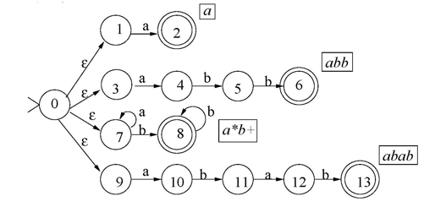
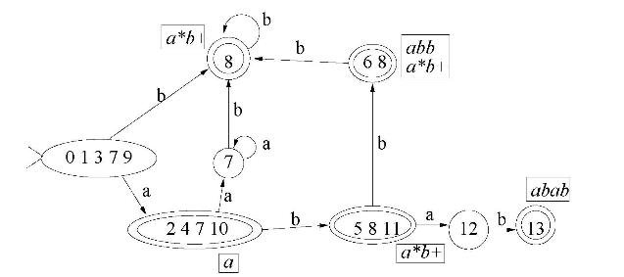
NFA to DFA / Subset Construction Method (Exercise 2)
NFA
DFA
Hints

Slide 30
Deterministic Finite Machine
DFA DESIGN
A finite automaton is a 5-tuple (Q, Σ, δ, q₀, F), where
Q is a finite set called the states,
Σ is a finite set called the alphabet,
δ : Q × Σ → Q is the transition function,
q₀ ∈ Q is the start state,
F ⊆ Q is the set of accept (final) states.
If A is the set of all strings that a machine M accepts, we say that A is the language of machine M and write L(M)=A, M recognizes A or M accepts A.

Slide 31
Deterministic Finite Machine
DFA Example 1
0
1
1
0
q₁
q₂
q₃
DFA DESIGN
M₁ = (Q, Σ, δ, q₀, F), where –
Q = {q₁, q₂, q₃},
Σ = {0, 1},
δ is describe as –
q₀ = q₁,
F = {q₂}.
0,1
Figure: Finite Automaton M₁
δ | 0 | 1
q₁ | q₁ | q₂
q₂ | q₃ | q₂
q₃ | q₂ | q₂
δ(q₁,0) = q₁, δ(q₁,1) = q₂,
δ(q₂,0) = q₃, δ(q₂,1) = q₂,
δ(q₃,0) = q₂, δ(q₃,1) = q₂.
or

Slide 32
0
DFA Design Example
a₁
1
Alphabet Σ={0,1,2}.
Language A₁ = {w : the sum of all the symbols in w is multiple of 3 }.
Can be represented as follows –
S= the sum of all the symbols in w.
If S modulo 3 = 0 then the sum is multiple of 3.
So the sum of all the symbols in w is 0 modulo 3.
Here, a_{i} is modeled as S modulo 3 = i.
The finite state machine M₁= (Q₁, Σ, δ₁, q₁, F₁), where –
Q₁ = {a₀,a₁,a₂},
q₁ = a₀,
F₁ = {a₀},
δ₁ | 0 1 2 . a₀ | a₀ a₁ a₂ a₁ | a₁ a₂ a₀ a₂ | a₂ a₀ a₁
2
1
2
0
a₀
2
a₂
1
0
Input example: 01120101
Present State:
Input symbol:
Accepted
a₂
a₁
a₀
01120101
01120101
01120101
01120101
01120101
01120101
ε
01120101
01120101

Slide 33
DFA Design Example
Alphabet Σ={0,1,2}.
Language A₁ = {w : the sum of all the symbols in w is an even number }.
Can be represented as follows –
S= the sum of all the symbols in w.
If S modulo 2 = 0 then the sum is even.
Here, b_{i} is modeled as S modulo 2 = i.
The finite state machine M₂= (Q₂, Σ, δ₂, q₂, F₂), where –
Q₂ = {b₀,b₁},
q₂ = b₀,
F₂ = {b₀},
δ₂ | 0 1 2 . b₀ | b₀ b₁ b₀ b₁ | b₁ b₀ b₁
b₀
1
b₁
0,2
1
0,2
Input example: 01120101
Present State:
Input symbol:
Accepted
b₀
b₁
01120101
01120101
01120101
01120101
01120101
01120101
01120101
01120101
ε

Slide 34
DFA Design Example (Type 1)
The construction of DFA for languages consisting of strings ending with a particular substring.
Determine the minimum number of states required in the DFA.
Calculate the length of substring.
All strings ending with ‘n’ length substring will always require minimum (n+1) states in the DFA.
Draw those states.
Decide the strings for which DFA will be constructed.
Construct a DFA for the decided strings
While constructing a DFA, Always prefer to use the existing path. Create a new path only when there exists no path to go with.
Send all the left possible combinations to the starting state.
Do not send the left possible combinations over the dead state.

Slide 35
DFA Design Example and Exercise
Draw a DFA for the language accepting strings ending with ‘abb’ over input alphabets ∑ = {a, b}
Draw a DFA for the language accepting strings starting with ‘ab’ over input alphabets ∑ = {a, b}
Draw a DFA for the language accepting strings ‘ab’ in the middle (sub string) over input alphabets ∑ = {a, b}

Slide 36
FIRST and FOLLOW
Course Code: CSC3220
Course Title: Compiler Design
Dept. of Computer Science
Faculty of Science and Technology
Lecturer No: | 9 | Week No: | 9 | Semester:
Lecturer: | Md Masum Billah, billah.masumcu@aiub.edu

Slide 37
Lecture Outline
Review of Subset Construction Rule (NFA to DFA conversion)
Overview of First and Follow
First and Follow set Rules
Examples
Exercises

Slide 38
Objective and Outcome
Objective:
To Explain the necessity or requirement of FIRST and FOLLOW set calculation.
To elaborate the method/algorithm of FIRST and FOLLOW calculation from a given CFG.
To provide necessary example and exercise of FIRST and FOLLOW calculation from a given CFG
Outcome:
After this class the students will know the necessity of FIRST and FOLLOW calculation
After this class the students will be able to demonstrate the FIRST and FOLLOW calculation method.
The students will also be capable of calculating FIRST and FOLLOW set from a given CFG

Slide 39
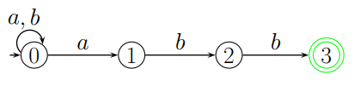
Review on NFA to DFA
Example
A NFA for the language, L3 = {a, b}∗{abb}.
Given NFA

Slide 40
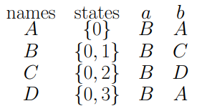
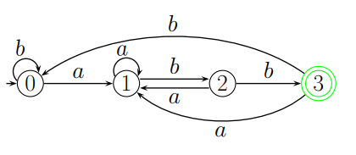
Review on NFA to DFA
Example
Converted DFA

Slide 41
FIRST and FOLLOW Overview
The basic problem in parsing is choosing which production rule to use at any stage during a derivation.
Lookahead
Means attempting to analyze the possible production rules which can be applied, in order to pick the one most likely to derive the current symbol(s) on the input.
FIRST and FOLLOW
We formalize the task of picking a production rule using two functions, FIRST and FOLLOW. we need to find FIRST and FOLLOW sets for a given grammar, so that the parser can properly apply the needed rule at the correct position.

Slide 42
FIRST Set Calculation
Rules
1. If X is terminal, FIRST(X) = {X}. 2. If X → ε is a production, then add ε to FIRST(X). 3. If X is a non-terminal, and X → Y1 Y2 … Yk is a production, and ε is in all of FIRST(Y1), …, FIRST(Yk), then add ε to FIRST(X). 4. If X is a non-terminal, and X → Y1 Y2 … Yk is a production, then add a to FIRST(X) if for some i, a is in FIRST(Yi), and ε is in all of FIRST(Y1), …, FIRST(Yi-1).
Applying rules 1 and 2 is obvious. Applying rules 3 and 4 for FIRST(Y1 Y2 … Yk) can be done as follows:
Add all the non-ε symbols of FIRST(Y1) to FIRST(Y1 Y2 … Yk). If ε ∈ FIRST(Y1), add all the non-ε symbols of FIRST(Y2). If ε ∈ FIRST(Y1) and ε ∈ FIRST(Y2), add all the non-ε symbols of FIRST(Y3), and so on. Finally, add ε to FIRST(Y1 Y2 … Yk) if ε ∈ FIRST(Yi), for all 1 ≤ i ≤ k.

Slide 43
First Set
The algorithm to compute the firsts set of a symbol X:
if(X is a terminal symbol):
first(X) = X;
break;
if (X -> ℇ ∈ productions of the grammar):
first(X).add({ ℇ });
foreach(X -> Y1....Yn ∈ productions of the grammar):
j = 1;
while (j <= n):
first(X).add({ b }), ∀ b ∈ first(Yj) ;
if ( ℇ ∈ first(Yj)):
j ++;
else:
break;
if(j = n+1):
first(X).add({ ℇ });

Slide 44
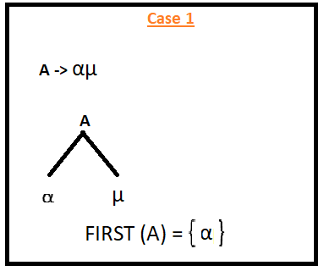
First Set (Case 1)
For a Production, if the first things is terminals that terminal (left most) would be considered as a ‘First’
If the Left most thing is a terminals then that terminals will be ‘First’
Don’t worry about the rest of the things residing on the right side of the first terminals

Slide 45
First Set (Case 2)
For a Production, if the first things is epsilon (ε) then ‘FIRST’ is epsilon (ε)

Slide 46
First Set (Case 3)
For a Production, if the first things is Non-Terminals, then we should continue until we found a terminals.
Look for the next production and next until we encounter a terminals

Slide 47

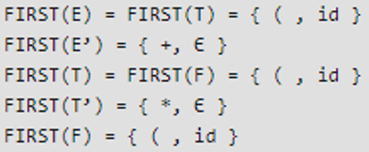
First Set (Example 1)
Problem
Solution

Slide 48

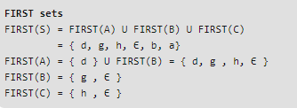
First Set (Example 2)
Problem
Solution

Slide 49
Follow Set
Rules
Follow should be look for right side of anything
Follow always starts with $
Follow(X) to be the set of terminals that can appear immediately to the right of Non-Terminal X in some sentential form.
FOLLOW (S) = { S } // where S is the starting Non-Terminal
If A -> pBq is a production, where p, B and q are any grammar symbols, then everything in FIRST (q) except ε is in FOLLOW (B)
If A->pB is a production, then everything in FOLLOW(A) is in FOLLOW (B)
If A->pBq is a production and FIRST(q) contains ε, then FOLLOW (B) contains { FIRST(q) - ε} U FOLLOW (A)

Slide 50
Follow Set
Rules
Apply the following rules: 1. If $ is the input end-marker, and S is the start symbol, $ ∈ FOLLOW(S). 2. If there is a production, A → αBβ, then (FIRST(β) – ε) ⊆ FOLLOW(B). 3. If there is a production, A → αB, or a production A → αBβ, where ε ∈ FIRST(β), then FOLLOW(A) ⊆ FOLLOW(B).
Note that unlike the computation of FIRST sets for non-terminals, where the focus is onwhat a non-terminal generates, the computation of FOLLOW sets depends upon where the non-terminal appears on the RHS of a production

Slide 51
Follow Set (Case 1-a)
Follow means something right behind of it.
Follow means the next one
If the next of a thing (whos Follow should be calculated) terminal/nonterminal then we must find the ‘FIRST’ of that terminal/nonterminal
That particular ‘FIRST’ would be the designated ‘FOLLOW’ of the things (whos Follow should be calculated)

Slide 52
Follow Set (Case 1-b)
Follow means something right behind of it.
Follow means the next one
If the next of a thing (whos Follow should be calculated) terminal/nonterminal then we must find the ‘FIRST’ of that terminal/nonterminal
That particular ‘FIRST’ would be the designated ‘FOLLOW’ of the things (whos Follow should be calculated)

Slide 53
Follow Set (Case 2)
We never write epsilon (ε) in ‘FOLLOW’
If we do not have anything on right side
That is, if we do not have an ‘FOLLOW’ then we will take the ‘FOLLOW’ (all FOLLOW) of its parent (non-terminal) (from which the production came)

Slide 54
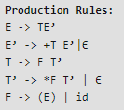
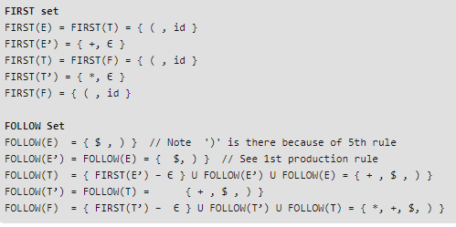
Follow Set (Example 1)
Problem
Solution

Slide 55

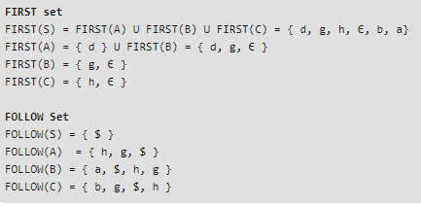
Follow Set (Example 2)
Problem
Solution

Slide 56
First and Follow Set
Example
Grammar | First | Follow
S->ABCDE | {a, b, c} | { $ }
A-a/epsilon | {a, epsilon} | {b, c}
B->b/epsilon | {b, epsilon} | {c}
C->c | {c} | {d, e, $}
D->d/epsilon | {d, epsilon} | {e, $ }
E->e/epsilon | {e, epsilon} | {$}

Slide 57
Parsing and Parsing Table
Course Code: CSC3220
Course Title: Compiler Design
Dept. of Computer Science
Faculty of Science and Technology
Lecturer No: | 10 | Week No: | 10 | Semester:
Lecturer: | Md Masum Billah; billah.masumcu@aiub.edu, Masum.Billah.net

Slide 58
Lecture Outline
Quiz
Parsing
Parsing Technique(LL1 Grammar)
Parsing Table Construction Technique
Examples
Exercises

Slide 59
Objective and Outcome
Objective:
To provide an overview of parsing and parsing types.
To give an overview of predictive parser
To demonstrate the predictive parsing table construction for predictive / LL(1) parser from a given CFG
Outcome:
After this lecture the students will be able to understand basics of predictive and LL (1) parser.
The students will be capable of constructing a predictive parsing table from given CFG

Slide 60
Quiz
Quiz

Slide 61
Parsing
The process of determining if a string of terminals (tokens) can be generated by a grammar.
Time complexity:
For any CFG there is a parser that takes at most O(n³) time to parse a string of n terminals.
Linear algorithms suffice to parse essentially all languages that arise in practice.
Two kinds of methods:
Top-down: constructs a parse tree from root to leaves
Bottom-up: constructs a parse tree from leaves to root

Slide 62
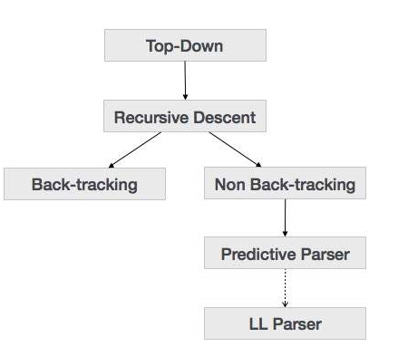
Types of Parsing

Slide 63
Parsing Table Overview
A Parsing table collects information from FIRST and FOLLOW set.
A Parsing table provides a direction/predictive guideline for generating a parse tree from a grammar.
A Parsing table provide information to create moves made by a predictive parser on a specific input.

Slide 64
LL(k) LL(1) Parser Design Prerequisite
Make the grammar suitable for top-down parser. By performing the elimination of left recursion. And by performing left factoring.
Find the FIRST and FOLLOW of the variables.
Create Parsing table based on the information from FIRST and FOLLOW sets.

Slide 65
Predictive (LL1) Parsing Table Construction Rule
Collect information from FIRST and FOLLOW sets into a predictive parsing Table M[A,a]
M[A,a] is a 2D array where
A nonterminal
A is a terminal or the symbol $, the input endmarker
The Production A -> a is chosen if the next input symbol a is in First (a).
If a = ε, we should again choose A-> a, if the current input symbol is in FOLLOW (A) or if the $ on the input has been reached and $ is in the FOLLOW(A)

Slide 66
Predictive (LL1) Parsing Table Construction Rule
From a Grammar Find out First and Follow
Take a production; Row should be left hand side and column should be first of right and side
If we see epsilon in first of right hand side, place the production in follow also
If first of right hand side terminal, directly place in table
If the first of right hand side is epsilon, directly place in follow of left hand side

Slide 67
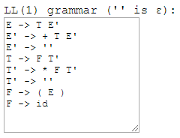
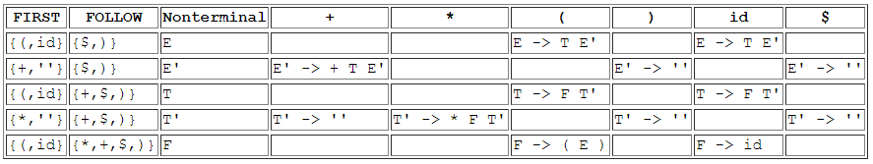
Parsing Table Construction (Example)

Slide 68
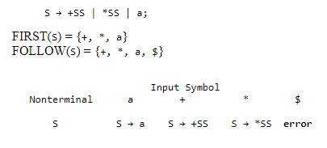
Predictive parsing table for the grammar (Example 1)

Slide 69
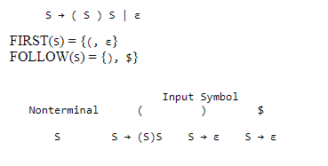
Predictive parsing table for the grammar (Example 2)

Slide 70
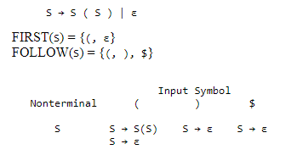
Predictive parsing table for the grammar (Example 3)

Slide 71
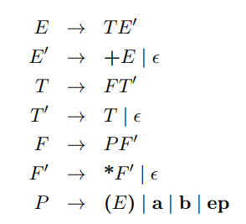
Parsing Table Construction (Problem)
Consider the following LL(1) grammar, which has the set of terminals T = fa; b; ep; +; *; (; )g. This grammar generates regular expressions over fa, bg, with + meaning the RegExp OR operator, and ep meaning the ε symbol. (Yes, this is a context free grammar for generating regular expressions!)

Slide 72
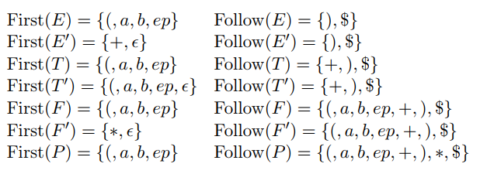
Parsing Table Construction (Solution)
FIRST and FOLLOW sets

Slide 73
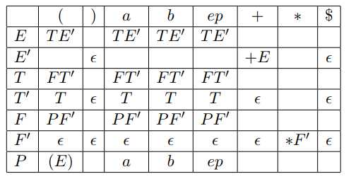
Parsing Table Construction (Solution)
LL (1) Parsing Table

Slide 74
Stack Movement Predictive parser
Course Code: CSC3220
Course Title: Compiler Design
Dept. of Computer Science
Faculty of Science and Technology
Lecturer No: | 11 | Week No: | 11 | Semester:
Lecturer: | billah.masumcu@aiub.edu

Slide 75
Lecture Outline
First, Follow and Parsing Table Exercise and Practice
Non-Recursive predictive parsing
Stack Movement of Predictive parser

Slide 76
Objective and Outcome
Objective:
To review predictive parsing table construction with example
To elaborate the necessity of stack movement by a predictive parser
To explain non-recursive predictive parsing algorithm
Demonstrate stack movement of a predictive parser for a certain input with example
Outcome:
The student will improve their ability of FIRST, FOLLOW and parsing table construction skills.
After this class the students will understand non-recursive predictive parsing algorithm
The students will be capable of demonstrating stack movement of a predictive parser for a certain given input string from given Grammar (CFG)

Slide 77
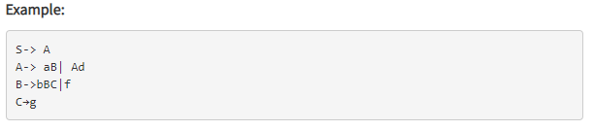
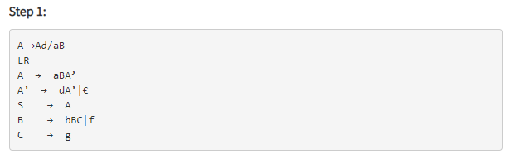
Predictive parsing table for the grammar (Example)

Slide 78
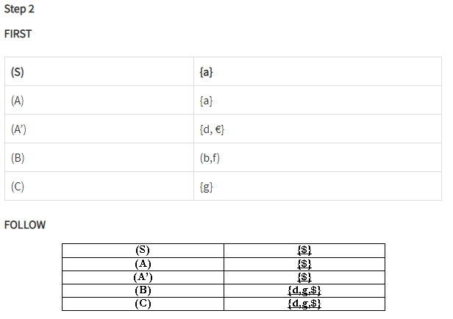
Predictive parsing table for the grammar (Example)

Slide 79
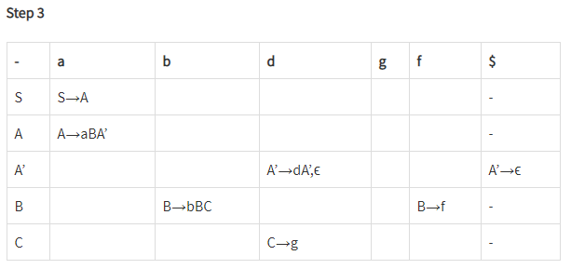
Predictive parsing table for the grammar (Example)

Slide 80
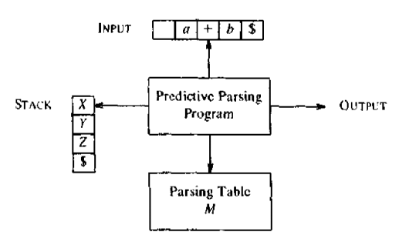
Non Recursive Predictive Parsing
Algorithm
It is possible to build a non recursive predictive parser by maintaining a stack.
The key problem during predictive parsing is that determining the production to be applied for a nonterminal.
The non recursive parser looks up the production to be applied in the parsing table.

Slide 81
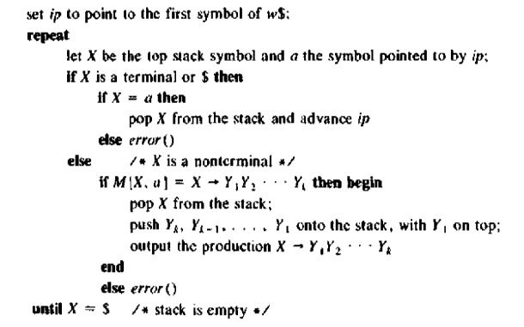
Non Recursive Predictive Parser
Algorithm
Input: A String (input) w, a parsing table M and a grammar G
Output: If w is in L(G), a leftmost derivation of w; or error
Method: Initially, the parser is in a configuration in which it has $S on the stack with S, the start symbol of G on top, and w$ in the input buffer. The program that utilizes the predictive parsing table M to produce a parse for the input

Slide 82
Stack Movement
Non Recursive Predictive Parser Method
With the help of FIRST, FOLLOW and associated Parse Table predictive parser makes moves
With a certain input string the predictive parser makes the sequence of moves
The input pointer points to the leftmost symbol of the string in the input column
It is tracing out a leftmost derivation for the input, the productions output are those of a leftmost derivation
The input symbols that have already been scanned, followed by the grammar symbols on the stack (from top to bottom), make up the left-sentential forms in the derivation.

Slide 83
Parsing Table Construction (Example 1)

Slide 84
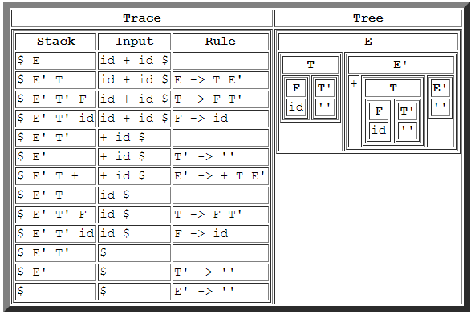
Stack Movement a Predictive Parser (Example 1)
Given input String: id + id

Slide 85
Parsing Table Construction (Example 2)
Consider the following LL(1) grammar, which has the set of terminals T = fa; b; ep; +; *; (; )g. This grammar generates regular expressions over fa, bg, with + meaning the RegExp OR operator, and ep meaning the ε symbol. (Yes, this is a context free grammar for generating regular expressions!)

Slide 86
Parsing Table Construction (Example 2)
FIRST and FOLLOW sets

Slide 87
Parsing Table Construction (Example 2)
LL (1) Parsing Table

Slide 88
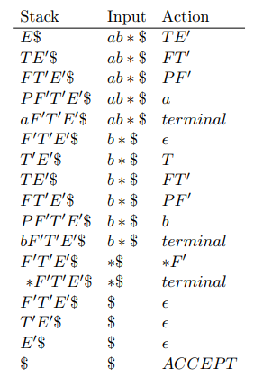
Parsing Table Construction (Example 2)
operation of an LL(1) parser on the input string ab*.

